Slide 1
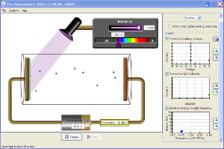
The photoelectric effect
Evidence for the particle (quantum) nature of light. See the JAVA applet on Moodle

Slide 2

The Quantum nature of radiation
For centuries it was accepted that light travels as particles (though with little direct evidence).
Largely based on my corpuscular theory of light
Isaac Newton 1642-1727

Slide 3
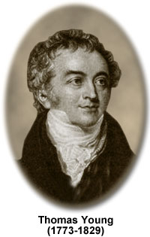
The Wave theory of radiation
However, this idea was overthrown after Young demonstrated beyond doubt the wave nature of light in his double slit experiment (1801).

Slide 4
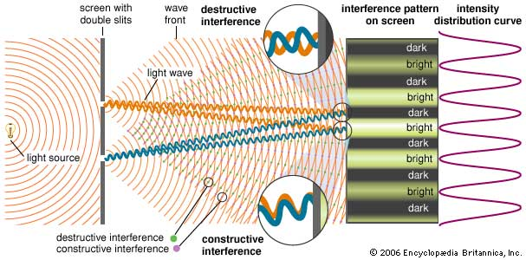
If we pass a wave through a pair of slits, an interference pattern is produced

Slide 5



Slide 6

The photoelectric effect
However, around the turn of the 20th century, an effect that became known as the photoelectric effect defied explanation using the wave model.
Oh no!

Slide 7
The photo-electric effect.
It was found that the leaf on a negatively charged gold-leaf electroscope slowly falls if a zinc plate resting on the top of the electroscope is irradiated with ultraviolet light.
Ultraviolet light
Zinc plate
Gold-leaf electroscope (negatively charged)

Slide 8
The photo-electric effect.
This can be explained by the zinc emitting electrons when the light shines on it. These emitted electrons are called photoelectrons.
e⁻
e⁻
Ultraviolet light
Zinc plate
Gold-leaf electroscope

Slide 9
The photo-electric effect
Further investigation with slightly more sophisticated apparatus demonstrated a number of interesting features:
Light source
-
+
photocurrent
A
-
+

Slide 10
12.1 Photoelectric effect simulation questions
You may wish to try this excellent PHeT simulation using the sheet to answer questions
http://phet.colorado.edu/en/simulation/photoelectric

Slide 11
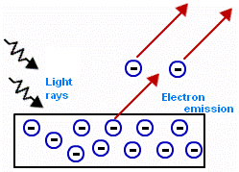
12.1 The photoelectric effect explained

Slide 12
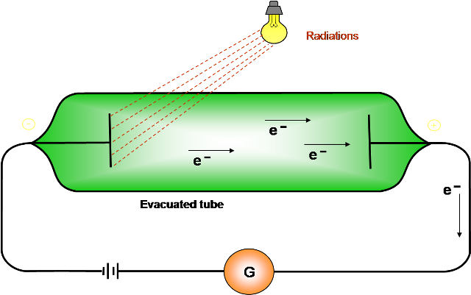
12.1 PHeT video

Slide 13
The photo-electric effect
The potential can be reversed until the flow of electrons is stopped. This is called the stopping potential.
Light source
+
-
A
+
-
V_{s}
Stopping potential

Slide 14
Interesting features
1. For every metal, there is a certain frequency of light (the threshold frequency), below which no electrons are emitted, no matter how intense the light.
K.E. of emitted electrons
Frequency
Threshold frequency (f_{o})

Slide 15
Interesting features
2. The number of photoelectrons emitted (the photo current) only depends on the intensity of light.
3. The stopping potential depends only on the frequency of light.

Slide 16
A few problems
It looks like my theory’s buggered!
Using classical physics it could not be explained why there is a threshold frequency below which no electrons are emitted. Surely if the light was intense enough, the electrons would gain enough energy to escape at any frequency? Also, why was there no time delay?

Slide 17

A few problems
Classical physics could also not explain why the number of electrons emitted depended only on the intensity and not the frequency.
I know someone who may be able to help.
Max Planck 1858 - 1947

Slide 18
Einstein to the rescue (again!)
Einstein suggested that the light is quantised (i.e. light comes in little packets of energy called quanta or photons). This was based on the work of Max Planck who first used this idea (although Planck didn’t realise the implication of his mathematical “trick” at the time) to explain blackbody radiation.

Slide 19
Photon energy
The photon energy is given by the following formula (which was used by Planck):
E = hf
where E is the energy contained in the photon (in Joules), h is Planck’s constant (6.63 x 10⁻³⁴ Js) and f is the frequency in hertz.

Slide 20
How does this help to explain the observations of the photoelectric effect?
Threshold frequency
An electron at the surface of the metal can absorb the energy from an incident photon of light. If the frequency is high enough, the electron can gain enough energy to escape the metal. Even if only one photon (very low intensity!) is incident, an electron can escape. Thus the ability for the effect to occur only depends on the frequency of the light. Even if millions of photons of lower energy light is incident on the metal, an electron can never get enough energy from a photon to escape.

Slide 21
Photons
Free electrons
Metal
-
-
-
-
-
-
-
Here, the photon energy is less than the minimum required for the electrons to escape – no electrons are produced

Slide 22
photoelectron
Photons
-
Free electrons
Metal
-
-
-
-
-
-
-
The photon energy is greater than the minimum required for the electrons to escape – photoelectrons are produced at a range of kinetic energies up to a maximum value.

Slide 23
Photons
Free electrons
photoelectron
-
Metal
-
-
-
-
-
-
-
The photon energy is just large enough to cause emission. Photoelectrons with zero kinetic energy are produced (!).

Slide 24
Work function (Ф)
So, some of the photons energy is needed to remove the electron (Ф), and any surplus becomes kinetic energy (E_{max}).
E = hf = Ф + E_{max}
E_{max} = hf - Ф

Slide 25
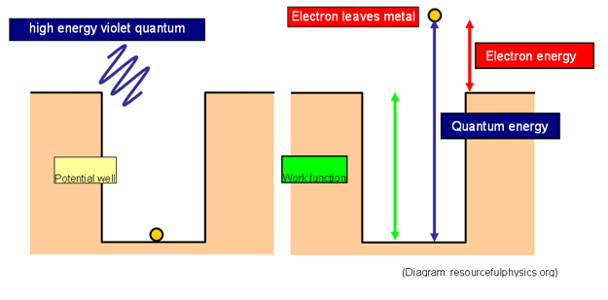
Work function (Ф)

Slide 26
Work function (Ф)
E_{max} = hf - Ф
E_{max}
gradient = h
f_{o} (threshold frequency)
f
An important graph to understand
-Ф_{o}

Slide 27
Work function (Ф) and threshold frequency (f_{o})
E_{max} = hf - Ф
At the threshold frequency, the KE of the ejected electrons is zero, so
Ф = hf_{o}

Slide 28
Stopping potential (V_{s})
Remember that the ejected electrons can be stopped by applying a potential difference to oppose their motion (the stopping potential). So
E_{max} = eV_{s} (= ½mv²)
where V_{s} is the stopping potential and e is the charge on an electron.

Slide 29
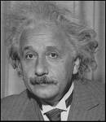
Nobel Prize
Einstein’s explanation meshed beautifully with experimental observations, and was ultimately verified by Robert Millikan (who first performed the experiment using the stopping potential with sufficient accuracy to verify Einstein’s formulae) in 1916. In 1921, Einstein received the Nobel prize in physics for the photoelectric effect.

Slide 30
An example
Light of wavelength 300 nm is incident on a sodium surface (work function 3.0 x 10⁻¹⁹ J). Calculate the maximum kinetic energy of the electrons emitted from the surface. (c = 3.0 x 10⁸ m.s⁻¹ and h = 6.63 x10⁻³⁴ Js)

Slide 31
An example
Light of wavelength 300 nm is incident on a sodium surface (work function 3.0 x 10⁻¹⁹ J). Calculate the maximum kinetic energy of the electrons emitted from the surface. (c = 3.0 x 10⁸ m.s⁻¹ and h = 6.63 x10⁻³⁴ Js)
hf = Ф + E_{max}
f = c/λ so
hc/λ = Ф + E_{max}
Rearranging and substituting;
E_{max} = 6.63 x 10⁻³⁴ x 3.0 x 10⁸ – 3.0 x 10⁻¹⁹ = 3.7 x 10⁻¹⁹ J
3.0 x 10⁻⁷

Slide 32
An example
So the maximum kinetic energy of an electron emitted by the sodium is 3.7 x 10⁻¹⁹ J.
Don’t forget that often in atomic physics energy is given in electronvolts. An electron volt is the energy given to an electron when it passes through a p.d. of 1 volt (= eV = 1.6 x 10⁻¹⁹ J). So the answer could be expressed as 2.3 eV)

Slide 33
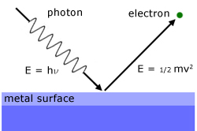
Photoelectric questions

Slide 34


